Slide 1
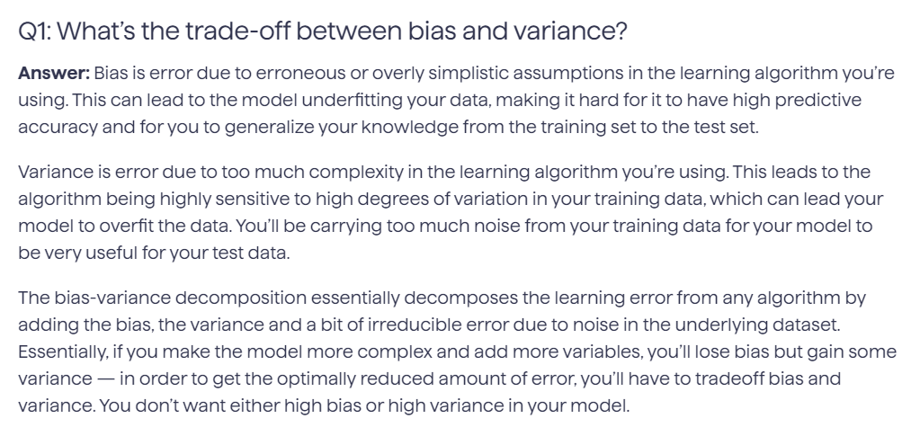

IBM IMPORTANT

Slide 2
